Slide 1


SPEAKER VERIFICATION
Capstone Project Phase B
Students:
Yonatan Ben Avraham
Deniss Nissim
Supervisors:
Dr. Renata Avros
Prof. Zeev Volkovich

Slide 2
Contents
Motivation
The model
GUI
UML
Testing plan
Results
Illustration

Slide 3
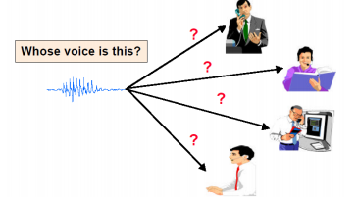
Motivation
The project is devoted to recognition of one of speaking within a group of persons speaking in the recording.
The project operates with short recordings processing.

Slide 4
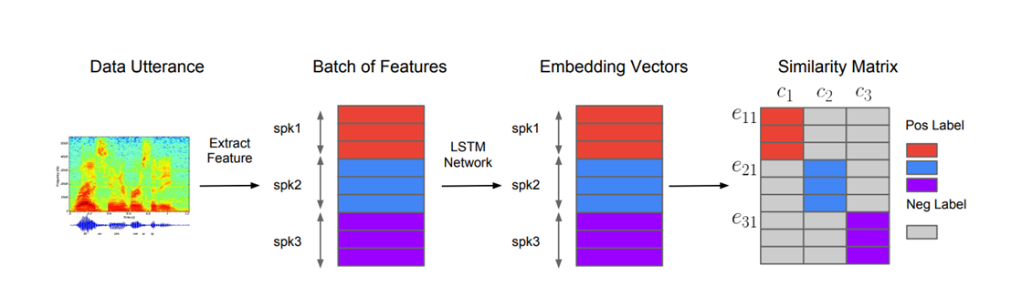
the model

Slide 5
Features Extraction
The model receives short audio recordings of speakers.
Wavelet Transform is performed on each of the recordings.
The output will be a matrix that represents features in the speaker's voice.

Slide 6
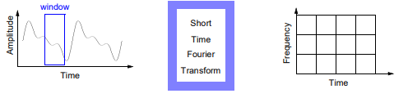
Short-Time Fourier Transform (stft)
STFT provides information on both When and at what frequencies a signal event occurs
The information is limited by the size of the window
The disadvantage is that the window is the same for all frequencies

Slide 7
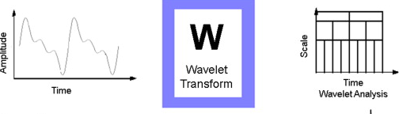
wavelet
The Wavelet Transform is a technique of windows of different sizes.
Wavelet transform is capable of providing the time and frequency information simultaneously.

Slide 8
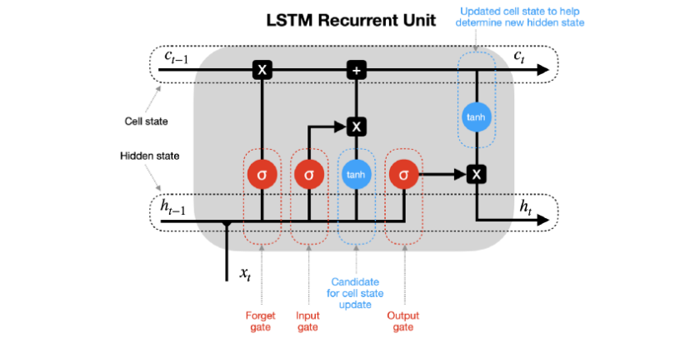
LSTM
More advanced version of RNN - preserve important information
Memory cells - store temporary state.
Gates - control the flow of information.
Notes:
LSTM is a more advanced version of RNNs that can preserve important information from earlier parts. The memory blocks contain memory cells and gates. The role of the memory cells is to store the temporary state of a network, with the role of the gates being to control the flow of information.

Slide 9


Embedding Vectors & Centroids Calculation
After we obtain the embedding we perform L2 Normalization on each output vector from the network.
Then, the centroid vector for each speaker is calculated. It represents the average vector among all the embeddings of the speaker.

Slide 10
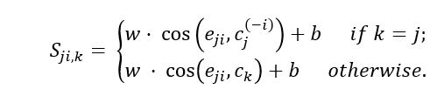
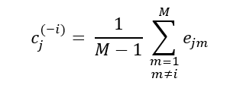
Similarity matrix
In the next step, after we calculated the centroids that represent each speaker, a similarity matrix is built.
The number of rows is the number of utterances in total and the number of columns is the number of speakers.

Slide 11

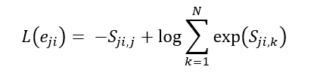
Loss Function
The total loss function of the model is described below:
Where L(eji):

Slide 12
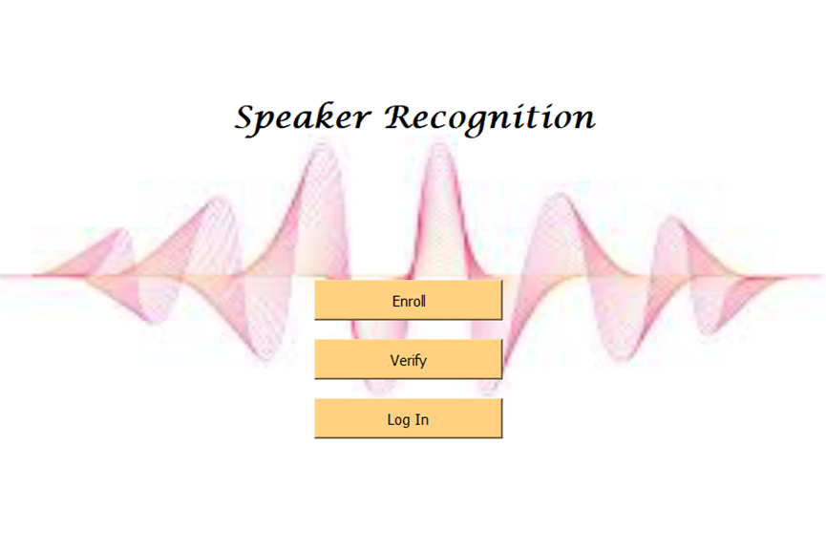
GUI

Slide 13
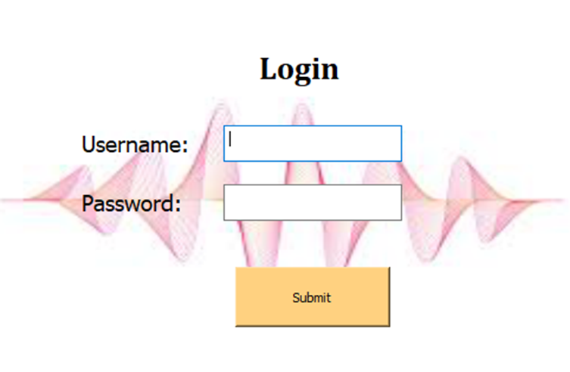
gui

Slide 14
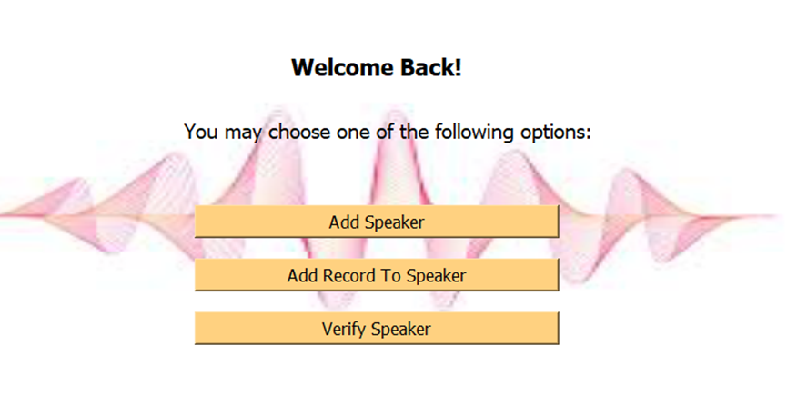
gui

Slide 15
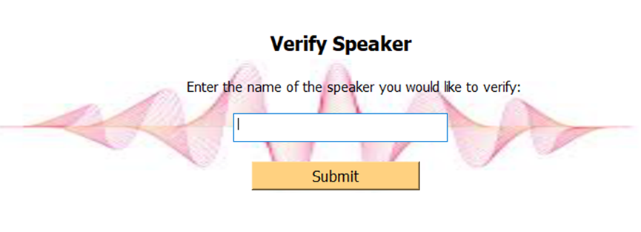
gui

Slide 16
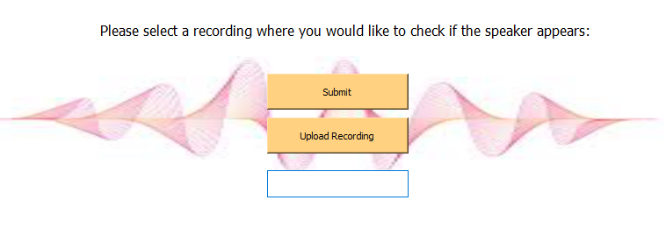
gui

Slide 17
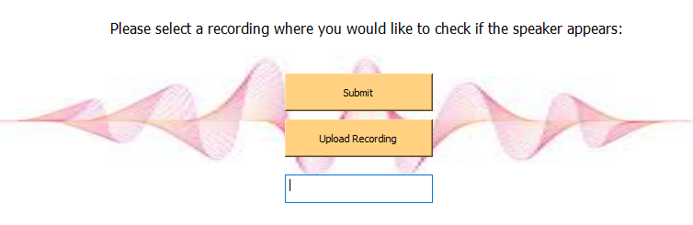
gui

Slide 18
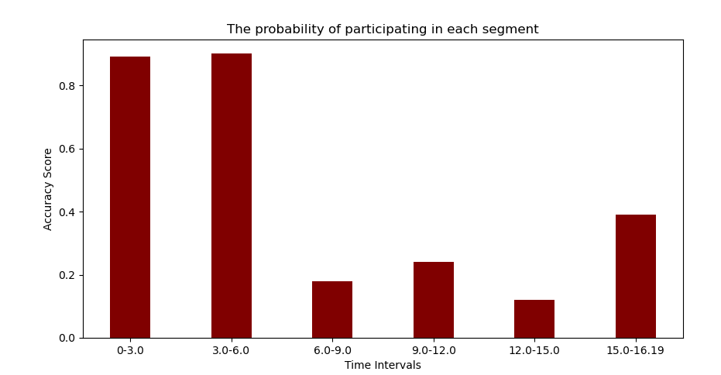
gui

Slide 19
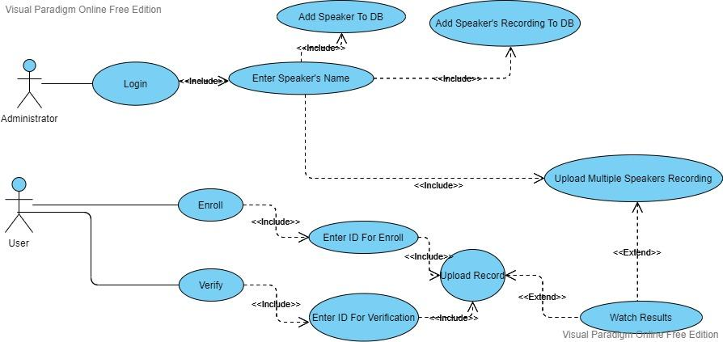
Use case diagram

Slide 20
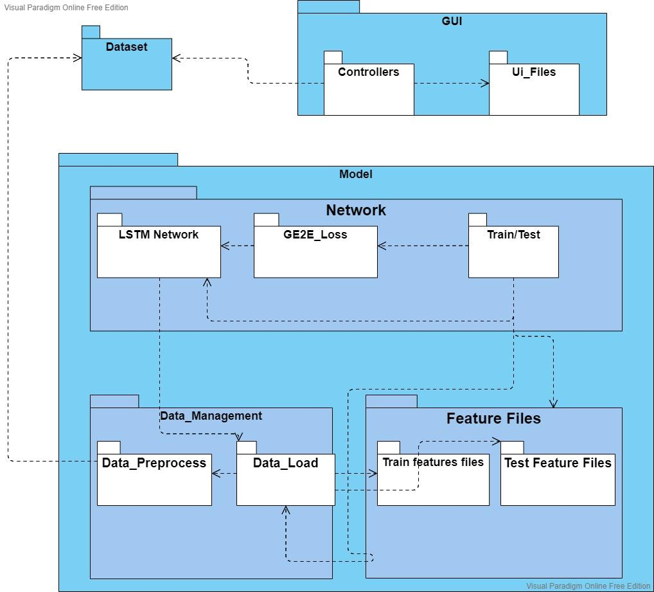
Package diagram

Slide 21
Training Results
Transform Type | Epochs | Loss
STFT | 800 | 0.0673
Sym2 | 800 | 0.0448
dmey | 800 | 0.1063
db8 | 800 | 0.0396
coif12 | 800 | 0.0658

Slide 22
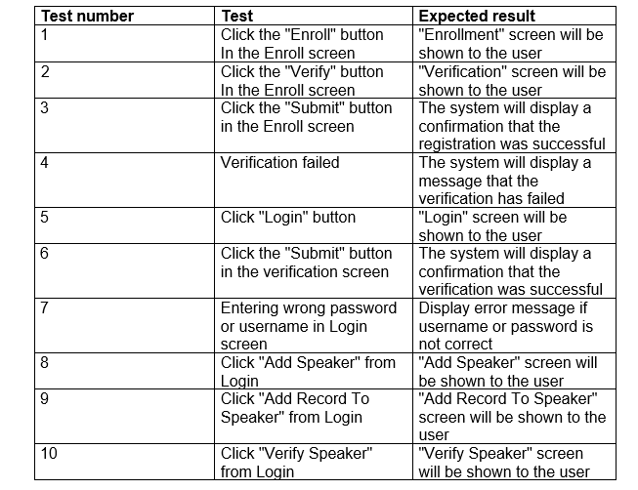
Testing plan

Slide 23
Program Illustration
https://drive.google.com/drive/u/0/folders/1LF-SBsq24nLylY_X_oSo-pIDdLzfRnGC

Slide 24



